Slide 1

Setting Up Selenium for Web Scraping in Python or R

Slide 2
Outline
Selenium requirements
Install Java. Add to path. https://www.oracle.com/java/technologies/downloads/
Install Chrome. https://www.google.com/chrome/
Download Chromedriver of the proper version of Chrome. https://googlechromelabs.github.io/chrome-for-testing/
Get setup. Sample code and instructions in github page.

Slide 3


Most User Friendly. Less flexible
Navigates static webpages. Not able to interact with webpage
More complex, but greater flexibility.
Navigates webpage interactively. Allows clicking, entering text, etc.

Slide 4
Github Page
github page.

Slide 5
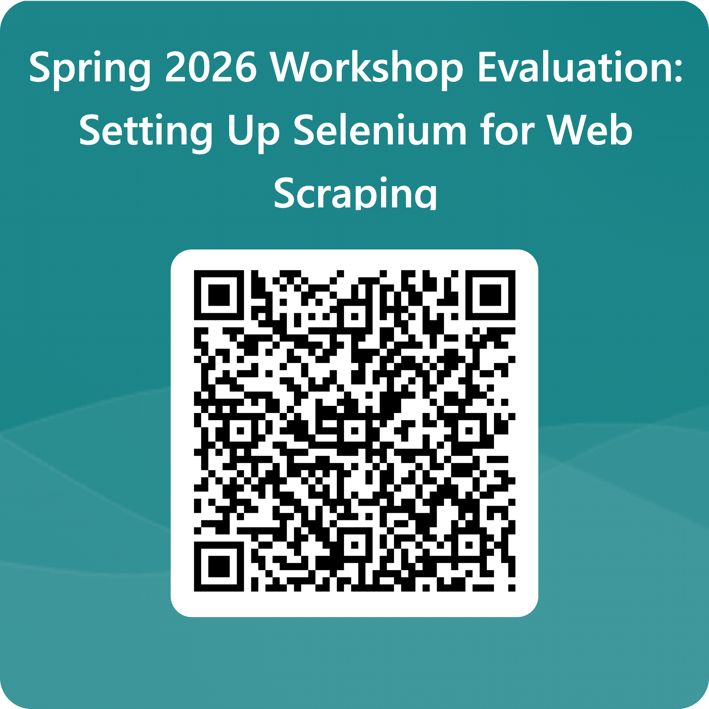
Evaluation

